Slide 1
Yocto Tutorial Beginner
Yaron Daniel

Slide 2
Syllabus
Introduction
Embedded system
Embedded Linux
Linux distribution build platforms
Petalinux compare Yocto
OpenEmbedded and Yocto
Yocto
Install and Build image
Bitbake
Poky
Layers
Bblayers.conf
Local.conf
Build system
Artifacts
Packages
Recipes
Recipes build task
Assignment and Basic assignment
Variables

Slide 3
Syllabus - continue
Yocto
Appends files
images
Classes
Kernel configuration
Uboot configuration
SDK
Practice
Yocto with Xilinx BSP layers
Xilinx Layers
Configuration
BSP Xilinx Configuration
Appendix – Rafael shield distro

Slide 4
Embedded Systems - Overview
Embedded system is a combination of a computer hardware and software designed for a specific function
The systems can be programmable or have a fixed functionality
Example include :
Automotive : modern cars commonly consist of many computers ,design to perform different tasks within vehicle . Such as adaptive cruise control ,forward collision warning , navigation system etc..
Mobiles phones : these consist of many embedded systems including GUI software and hardware , operating systems , cameras , microphone etc..
Industrial machines : sensors , automation system that perform specific monitoring and control function .
Medical equipment : sensors , control mechanism , complex OS for GUI , CT scan , X-ray , MRI , etc..

Slide 5
Embedded Systems – Characteristics
Consist hardware , software and firmware
Basic Hardware : processor, power supply, memory, flash,communication port.
Firmware : implement of FPGA
Software : embedded OS , application task.
Can be embedded in a large system to perform a specific function , as they are built for specialized task within the system.
Can be microprocessor or microcontroller and compute power.
Real time : require to perform their function under a time constraint to keep the larger system functioning properly (usually baremetal , linux by default is not real-time.)

Slide 6
Embedded Linux - Overview
Embedded linux refers to the use of the Linux Kernel , along with a comprehensive set of libraries and utilities, within embedded system or devices.
These systems, which are designed for specific functions, often feature constraints on resource like processing power, memory and energy consumption.
Linux due to its open-source nature, flexibility and robustness has become a popular choice for these systems.

Slide 7
Embedded Linux
A linux distribution or distro is an operating system made up of the linux kernel along with a package management system and various libraries , drivers and utilities .
In the context of the Embedded linux, a distribution is often stripped down and customized to fit the needs of the specific embedded system it’s intended to run on.
There are several linux distribution platform specifically designed for embedded systems, such as OpenWrt, Yocto and buildroot.

Slide 8
Linux distribution platforms
Buildroot : Based on set of Makefiles and patches that simplifies and automates the process of building a complete and bootable linux environment while using cross-compilation to allow building for multiple target platforms on a single linux based development system.
Easy to use
Limited configuration settings
Requires full image rebuild
OpenWrt : Is an open-source project for embedded based on linux , used on embedded devices to route network traffic . All the components have been optimized to be small enough to fit into the limited storage and memory available in home routers.
Focused on networking gear (routers)
Packages based updated
Yocto : Yocto project is an open source project imitated by linux foundation . It provide a set of tools and metadata that enable developers to build custom linux distributions for embedded systems.
PetaLinux : Is a development enviorment by Xilinx , a leading provider of FPGA and SOC solution . It designed to streamline the development process for embedded linux system on Xilinx devices . MPSOC and Zynq SOC.

Slide 9
PetaLinux compare Yocto Overview
PetaLinux Advantages
Specialized for Xilinx hardware – specifically tailored for Xilinx FPGA and SOC
Streamlined workflow – more integrated and streamlined for Xilinx development to Yocto – can reduce development time.
Xilinx support
Pre-built components – configuration optimized for Xilinx devices.
PetaLinux disadvantages
Vendor Xilinx – lock – not intended for other targets
Limited flexibility – lack of the flexibility and customization options provided by Yocto
Dependency on Xilinx tools – heavily relies on Xilinx development tools which can introduce dependencies and constraints in the development process .

Slide 10
PetaLinux compare Yocto Overview
Yocto Advantages
Platform independence – Yocto project can be used to build custom linux for a wide range of embedded .
Highly customization – Yocto offers extensive flexibility and customization options through its layer based architecture , allowing developers to tailor linux distribution to specific reequipment .
Large community support.
Yocto disadvantages
Learning curve – Yocto project has a steep learning curve , especially for beginner due to its complexity and extensive feature set. Getting started and mastering the workflow may require time and effort.
Configuration overhead – Yocto require more configuration and setup compared to petalinux. (can be less if we used Xilinx layers for Yocto)
Potential integration failures.
Summary: the choice between Petalinux and Yocto project depending on factors of hardware (Xilinx or not) , development preferences , customizations needs and resources (time) .

Slide 11
OpenEmbedded and Yocto
OpenEmbedded is the underlying build framework , while Yocto project builds upon it to provide a comprehensive set of tools , documents,and best practices for embedded linux development .
Developers often use the Yocto project to create custom linux distro for their embedded systems , leveraging both OpenEmbedded capabilities and additional features provide Yocto.

Slide 12
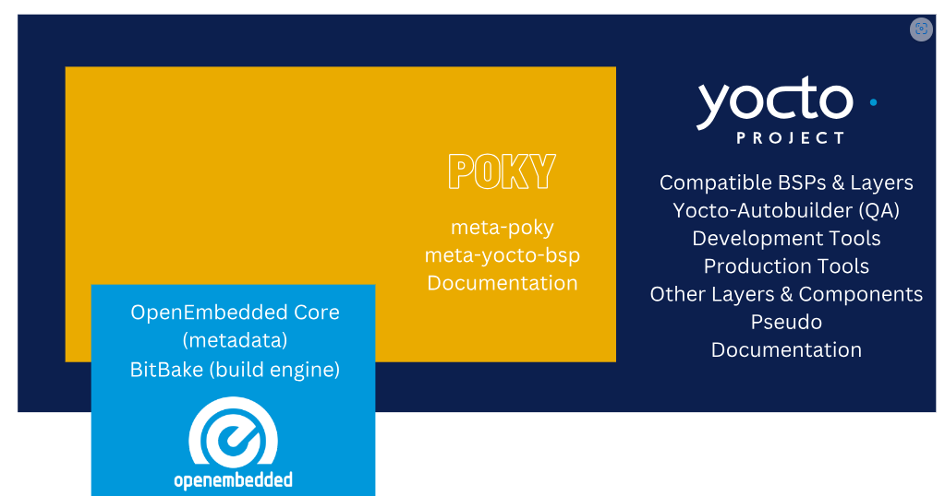
Yocto

Slide 13
Install and build image
Download page:
- https://docs.yoctoproject.org/4.0.18/brief-yoctoprojectqs/index.html (kirksotne version)
- Include step by step install (quick build) and system requirement according to branch version .
Releases tables: https://wiki.yoctoproject.org/wiki/Releases
Include data for supported versions and status
Notes:
13

Slide 14
Install and build image
Steps:
sudo mkdir -p /YoctoStudent
Sudo chown -R ubuntu /YoctoStudent
cd /YoctoStudent
Install Packages:
sudo apt install gawk wget git diffstat unzip texinfo gcc build-essential chrpath socat cpio python3 python3-pip python3-pexpect xz-utils debianutils iputils-ping python3-git python3-jinja2 libegl1-mesa libsdl1.2-dev python3-subunit mesa-common-dev zstd liblz4-tool file locales
sudo locale-gen en_US.UTF-8
git clone git://git.yoctoproject.org/poky
cd poky
git checkout -t origin/kirkstone -b my-kirkstone
. oe-init-build-env
export LC_ALL=C # for every terminal add this line to ~/.bashrc
bitbake core-image-minimal
Show on terminal (without run bitbake build – just check that bitbake is working)

Slide 15
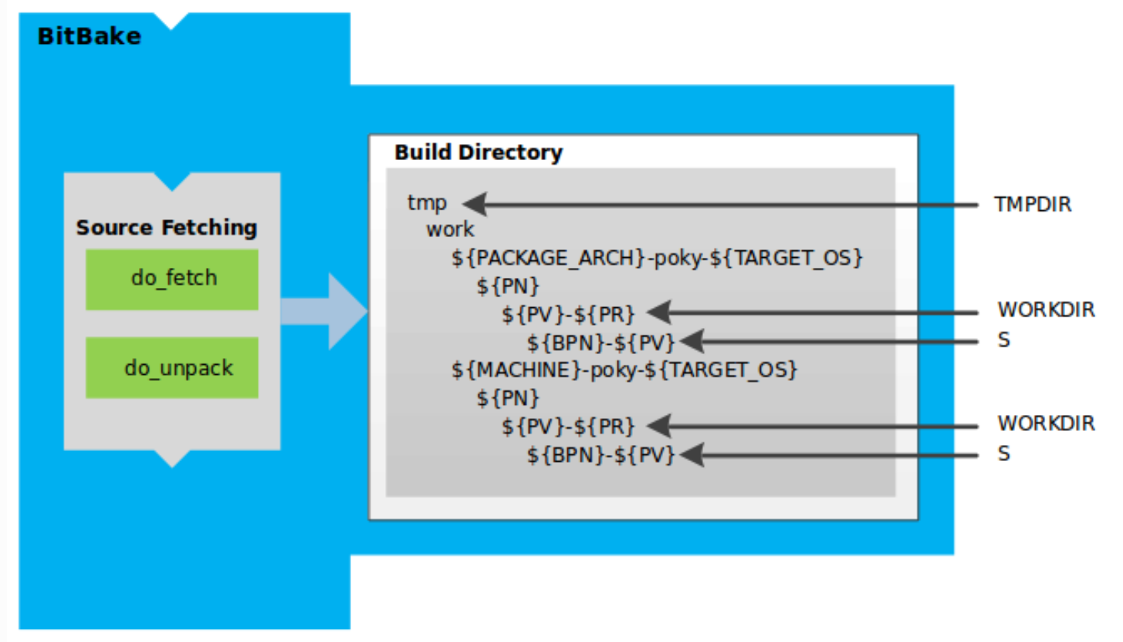
Bitbake
The task executor and scheduler used by the OpenEmbedded build system to build images.
It reads metadata , recipes and executes tasks defined in those files to build software packages and create images.
Build command:
Bitbake <image_name>
Bitbake <recipe_name>
Bitbake <recipe_name> -c <command>
Flag c is identify task to do with the recipe.
Clean command:
Bitbake <recipe_name> -c clean
Remove all output for a target : unpack,configure,install,compile,package
Bitbake <recipe_name> -c cleansstate
Remove shared state , and the clean task.
Bitbake <recipe_name> -c cleanall
Remove shared-state task and download source

Slide 16
Poky - Overview
Reference embedded distribution and a reference test configuration.
Poky provide the following :
A base-level functional distro used to illustrate to customize a distribution.
test the Yocto components
Includes : Bitbake ,tools,devtool,scripts OpenEmbedded-core,documentation and source of information.
Layers:
meta - This is the core layer , It includes the fundamental recipes, classes, and configurations needed to build a basic Linux system
meta-poky - These layers contain additional metadata , includes additional configuration and policy settings,
Meta-yocto-bsp - provides support for reference hardware platforms
Show link :
poky: Poky is a reference distribution of the Yocto Project®.

Slide 17
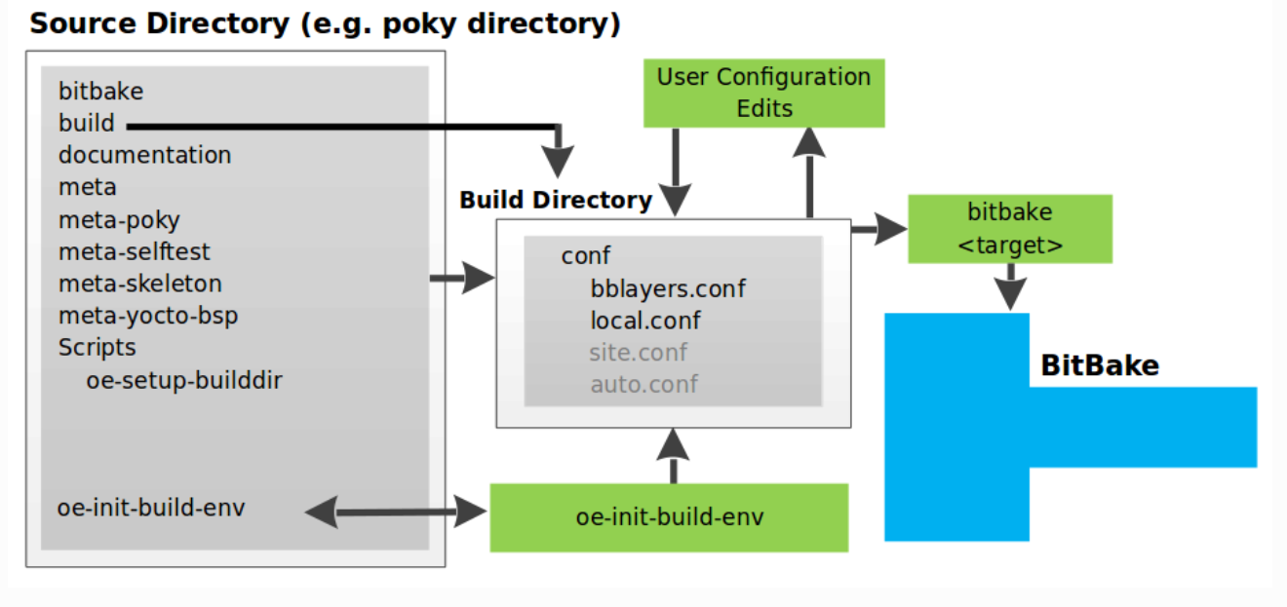
Poky User Configuration – Scheme

Slide 18
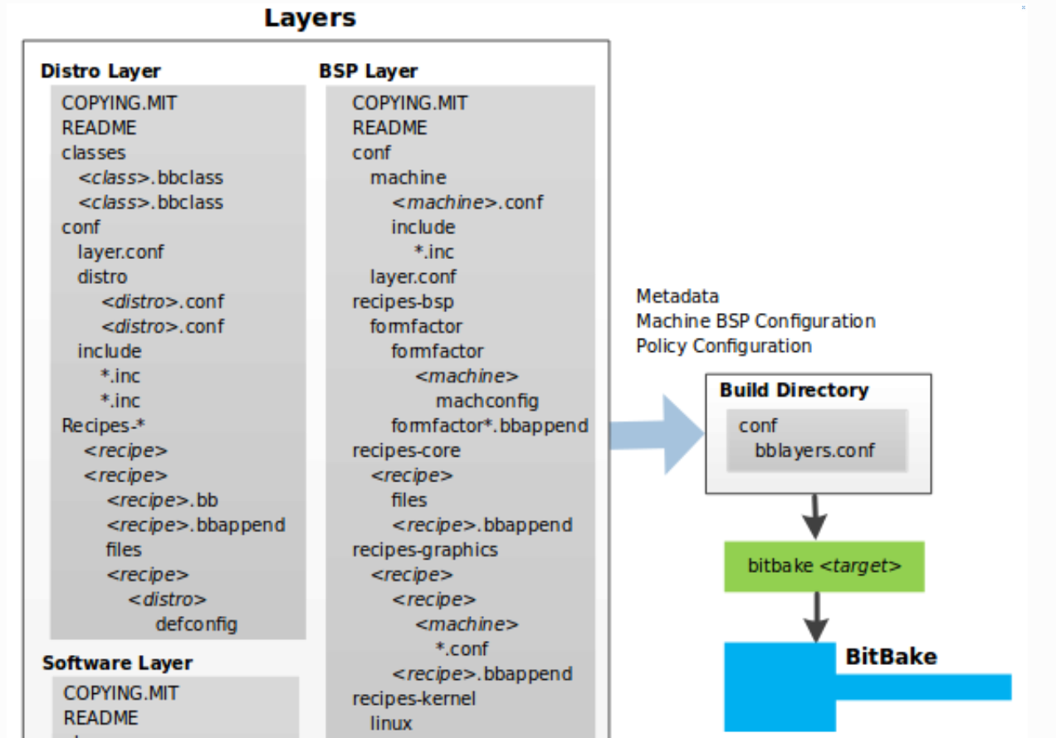
Layer Overview
A collection of related recipes . (such as graphic,multimedia,etc..)
Layer allow you to consolidate relate metadata to customize your build. (debug,oper,..etc)
Layer allow isolate information used when building for multiple architectures (projects).
Layer are hierarchical in their ability to override previous specifications.(bbappend,inherit bbclass)
You can include any number of available layers from the Yocto project and customize the build by add our layers (configure conf file,machine,device-tree ,etc..)
In this tutorial we will demonstrate and build our own layer.

Slide 19
Layer - bblayers.conf
bblayers.conf is a configuration file used by the build system.
In this file the set of layers are defined ,should be included in a build.
The bblayers.conf file specifies the location of each layer on the local file system.
This file actually manage the layers for build

Slide 20
Layers practical
Show on terminal commands:
Help : bitbake-layers –h
Show layers : bitbake-layers show-layers
Create layer : bitbake-layers create-layer <path/to/layer>
Add layer : bitbake-layers add-layer <path/to/layer>
Example:
Bitbake-layers create-layer ~/YoctoStudent
Bitbake-layers add-layer ~/YoctoStudent (from build dir)
Bitbake core-image-minimal

Slide 21
User Configuration Local.conf
Bitbake needs some basic configuration files in order to process a build, These files are *.conf
The minimally necessary ones as example files in the build/conf/local.conf
The local.conf file provides basic variables that define a build environment
Target Machine : $MACHINE :
Machine files includes settings about : target arch(x86,ARM) , bootloader,kernel,image type,compiler flags,soc configuration.
Download Directory $DL_DIR
Shared state directory $SSTATE_DIR
cache mechanisam design to speed up the build process by reusing previous build component.
Build Output $TMPDIR
Distribution policy $DISTRO
package management systems $PACKAGE_CLASSES
specify additional features to include $EXTRA_IMAGE_FEATURES
specify additional classes that should be applied $USER_CLASSES
Monitor disk $BB_DISKMON_DIRS
tracking changes $CONF_VERSION
Show on terminal Add : BB_CHECK_SSL_CERTS = “0” ; need to add it because security issue in WWW.

Slide 22
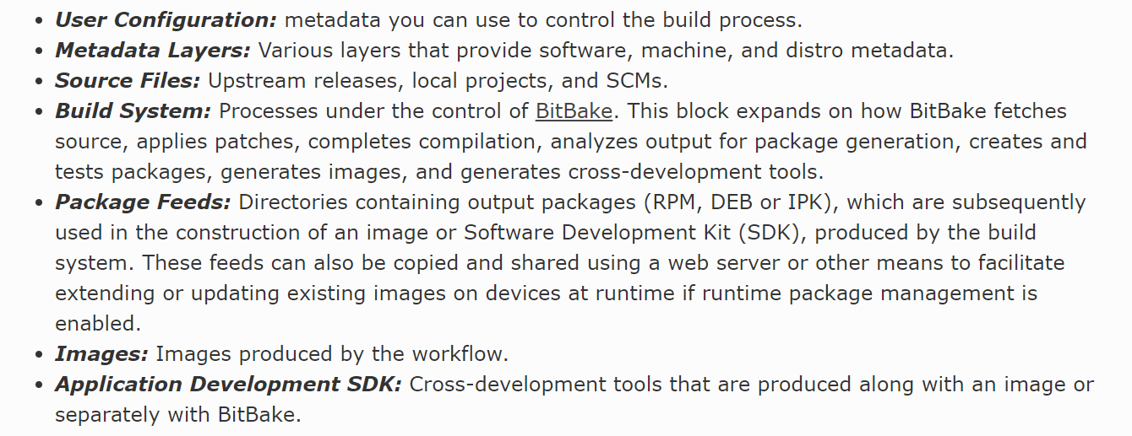
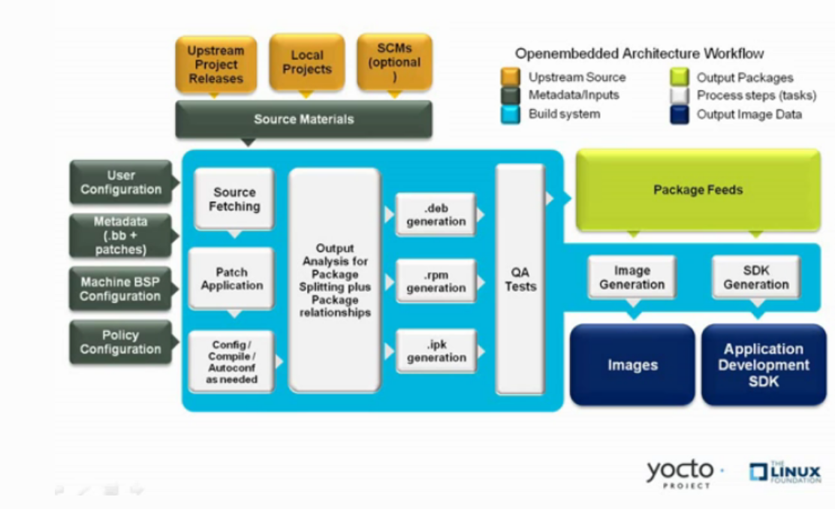
Build System concept

Slide 23
Artifacts location
Default General location
<project_name>/build/tmp/deploy/images/<machine>/
Machine qemux86-64: show on terminal
/var/yocto/tmp/deploy/images/qemux86-64/
Xilinx-Mpsoc
<project_name>/build/tmp/deploy/images/zcu102-zynqmp/
Boot.scr , boot.bin , <image_name>-<machine_name>-<machine>

Slide 24
Package Overview
refers to a recipes packaged output produced by Bitbake .
A package is generally the artifact binaries produced from the recipes sources .
There are 3 types of packages : rpm,deb,ipk :
Rpm : widely used in various linux distribution which derived from Red Hat , Fedora and Centos
Deb : used in Debian-based distribution like ubuntu
Ipk: used by OpenEmbedded which closely related to Yocto.
Configuration which type package to use selected in local.conf
Show on terminal
Commands to find recipes to install packages:
Bitbake-layers show-recipes bash
Find the recipe : find . –name bash* (should find from ~/poky)
Bitbake-layers show-recipes python3
Bitbake-layers show-recipes git

Slide 25
Package example
How to add packages to image
There are few ways to do it :
Local.conf to add IMAGE_INSTALL:append = “ <name_package/recipe>”
Add it in poky image name we use for example “core-image-minimal”
Use our own recipe we can create to build the image (will discuss later in images chapter)
Show on terminal
Example how to install package with local.conf , later in images section we will implement it by image recipes.
We can add the following line to add bash : IMAGE_INSTALL:append = “ bash” , save it.
Test is by run emulator : runqemu slirp nographic (from separate terminal)

Slide 26
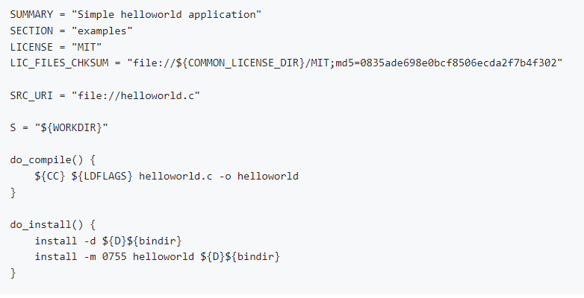
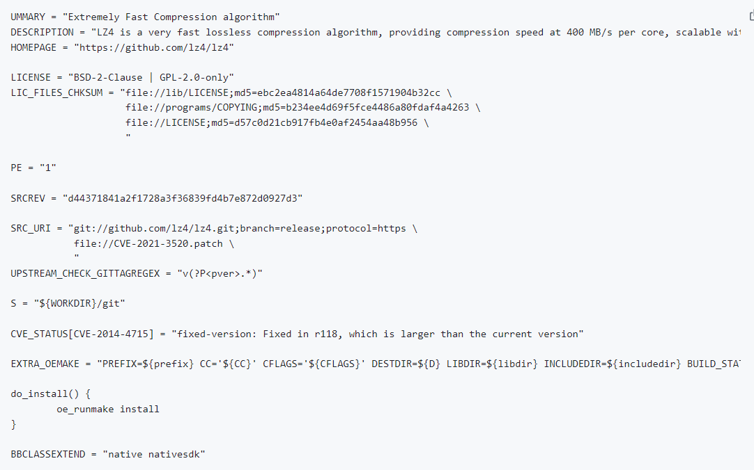
Recipes - Overview
A set of instruction for building packages.
A recipe describes where you get source code , which patches to apply , from where to fetch packages , how to configure the source , how to compile it and so on.
A recipes describes dependencies for libraries or for other recipes .
A Recipes represent the logical unit of execution. The software to build , the images to build and use the .bb file extension.

Slide 27
Recipes - example
Show on terminal how to use recipe to compile and build student app and use patch:
Steps:
mkdir -p recipes-app/student-app/files
Cp ../meta-skeleton/recipes-skeleton/hello-single/hello_1.0.bb recipes-app/student-app/student-app.bb
cp ../meta-skeleton/recipes-skeleton/hello-single/files/helloworld.c recipes-app/student-app/files/
Change the name build in .bb from ‘helloworld’ to ‘student-app’ .
Build and run
create patch :
cd recipes-app/student-app/files/
Copy the src file to other directory (files/tmp) and modify the print
diff –u <first_file_src> <sec_file_src> ; note the files should be with same name – please make the second file under files/tmp for this.
Add the patch file to recipe
Build and run

Slide 28
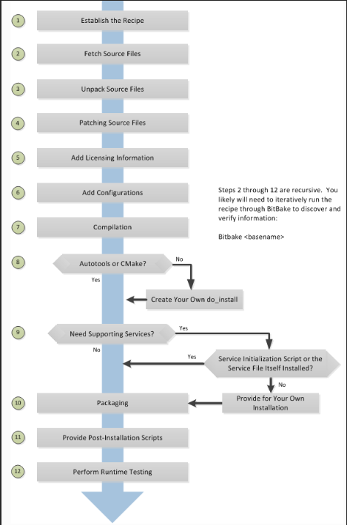
Recipe build task Overview and examples
List of all possible tasks: show on terminal
Bitbake –c listtasks <recipe>
Example Bitbake –c listtasks student-app
Each task we can use with the flag ‘-c’
Find tmp: bitbake –e student-app | grep ^S=
Bitbake –c cleanall student-app
Check log in tmp/temp/log.task_order
Bitbake –c unpack student-app
Check log in temp\log.task_order
Bitbake –c compile student-app
Check deploy file ‘student-app’ in tmp/
one level less

Slide 29
Recipe build task examples
Bitbake –c install student-app
Check log in temp\log.task_order

Slide 30
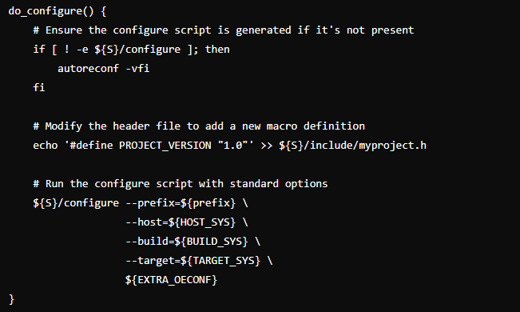
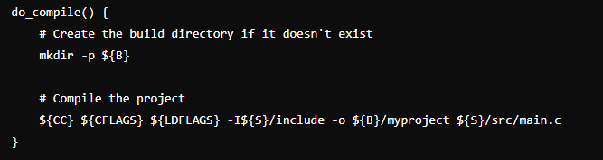
Recipes build tasks function example
Do_configure – configures the source by enabling and disabling any build-time and configuration options for the software being built.
Do_compile – compiles the source in the compilation directory
Show live on terminal
Commands:
Show build task : bitbake –c listtasks <recipe_name>
Check Ovelayed : Bitbake-layers show-overlayed

Slide 31
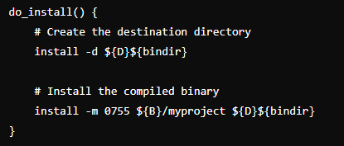
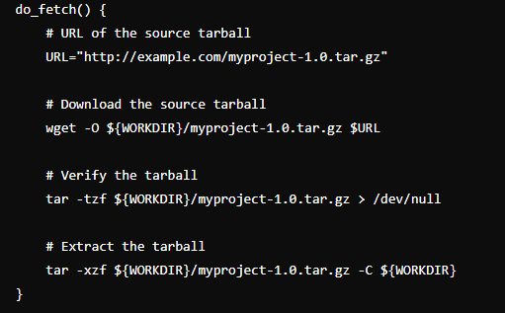
Recipes build tasks
Do_install – copies files and provide permissions from the compilation directory , which is defined by the ${WORKDIR}/${BP}/ to destination folder in ${WORKDIR}/image
Do_fetch – fetches the source code , this task uses the SRC_URI variable and the arguments prefix to determine the correct fetcher module . (default , not needed to implement )

Slide 32
Recipes build tasks
do_patch : Locates patch files and applies them to the source code - usually not need to implement it .
Unpack (do_upack) : Unpacks the source code into a working directory – usually not need to implement it.

Slide 33
Assignment
?= : This is used to assign the default value to variable. It can be overridden.
:= This is an immediate variable expansion. The value assigned is expanded immediately.
:append : This appends a value to a variable. The operator inserts no space between the current value and appended value. The effects are applied at variable expansion time rather than being immediately applied.
:prepend : similar to append – just the append is from the end to start
Example no space: A=“foo” , A:append = “bar” , A=“foobar”
Example with space : A=“foo” , A:append = “ bar” , A=“foo bar”
Example no space: A=“foo” , A:prepend = “bar” , A=“barfoo”
Example with space : A=“foo” , A:prepend = “ bar” , A=“bar foo”

Slide 34
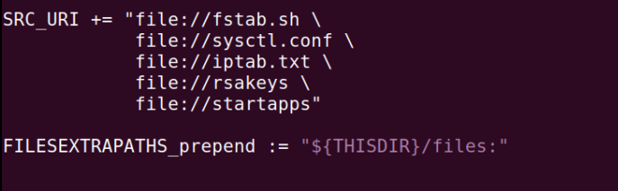
Basic Variables
FILESEXTRAPATHS_prepend : extend the search path the OpenEmbedded build system uses when looking for files and patches.
SRC_URI_append : the list of source files – local or remote .
IMAGE_INSTALL: used by recipe to specify the packages to install an image through the image class

Slide 35
Basic Variables
${WORKDIR} : the pathname of the work directory.
The directory is located within the TMPDIR directory structure
WORKDIR = ${TMPDIR}/work/${MULTIMACH_TARGET_SYS}/${PN}/${EXTENDPE}${PV}-${PR}
${TMPDIR} : the top level build output directory (build/tmp)
${MULTIMACH_TARGET_SYS} : the target system identifier .
${PN} : the recipe name ( package_name)
${PV} , ${PR} : recipe version ) package_version and revision)
Example : PN_PV_PR.bb example2_0.2_r0
S – Source
D – Destionion
B – Build directoty

Slide 36
Basic Variables
Show on terminal for example on student-app recipe
Read variable value syntax: Bitbake –e <recipe_name> | grep ^<Var_name>=
Bitbake –e <recipe_name> | grep ^WORKDIR=
Bitbake –e <recipe_name> | grep ^TOPDIR=
Bitbake –e <recipe_name> | grep ^PN=
Bitbake –e <recipe_name> | grep ^PV=
Bitbake –e <recipe_name> | grep ^PR=
Bitbake –e <recipe_name> | grep ^S=
Bitbake –e <recipe_name> | grep ^D=
List of all the variable and documentation of Yocto here:
Cat ~/poky/meta/conf/documentation.conf | grep <var_name>
Firefox ./documentation/ref-manual/variables.rst
12 Variables Glossary — The Yocto Project ® 5.0.999 documentation

Slide 37
License
List of licences ./meta/files/common-licenses
Use license MIT
Calculate of checksum by : md5sum

Slide 38
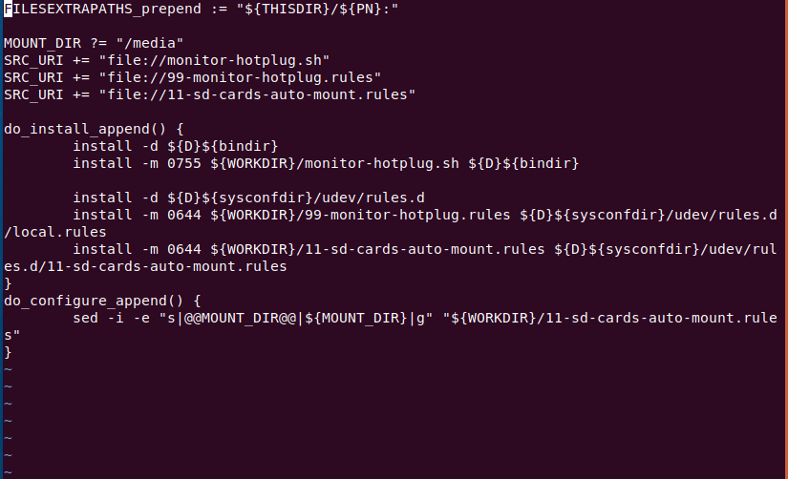
Append files - .bbappend
Files that append build information to a recipe file
Expected every append file to have a corresponding recipe .bb file. (this file should override)
The .bbappend file and .bb file should with the same name , for example : busybox_1.21.%.bbappend <-> busybox_1.21.1. bb
Information in append files extended or overrides the information in the similar-named recipe file.
The agenda is to use in .bb from other layer in other layer without to copy recipe and change it – layer agenda.

Slide 39
Append files - busybox
Busybox is commonly used to provide a lighweight set of Unix utilities.
Link to busy box example configuration utilities (defconfig)
poky/meta/recipes-core/busybox/busybox at master · CESARBR/poky (github.com)
Show on terminal how to modify busybox configuration by used of append files
List of configuration : poky/meta-poky/recipes-core/busybox/busybox/poky-tiny/defconfig
Mkdir <layer_name>/recipes-core
Copy from poky/meta-skeleton/recipes-core/busybox to our layer <layer_name>/recipes-core
Generate fragment by : bitbake busybox –c menuconfig ; bitbake busybox –c diffconfig
Copy devmem fragment from generated location to YoctoStudent/recipes-core/busybox/busybox/
Give meaning name = enable_devmem.cfg
Add the fragment name file to the append file
Bitbake busybox –c cleanall
Build and run
Command display all the appends
Bitbake-layers show-appends
Show priority layer : bitbake-layers show-layers

Slide 40
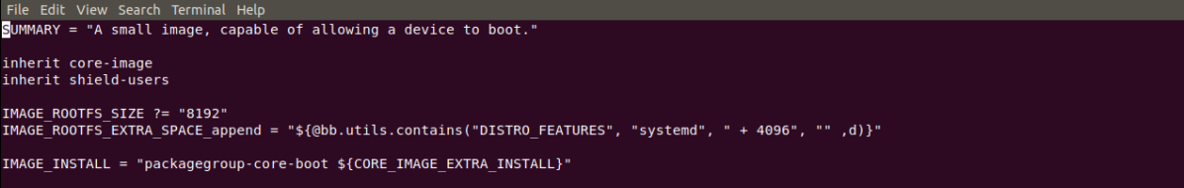

Image
An Image is an artifact of the BitBake build process given a collection of recipes and related metadata .
Images are the binary output that run on specific hardware or QEMU and are used for specific use-cases
You often need to create your own image recipe , in order to add new packages or functionally , rather than using the base images , which are provided by the base layers.
The simply way is to inherit image classes.
The output images located at : tmp/deploy/images/<machine_name>

Slide 41
Image Inherit
Inherit process while we build the image flow
Show in terminal how to prepare modified image :
Overview .bbclass image in poky : find . –name core-image*.bbclass – will discuss more in class section.
Copy core-image-minimal.bb to our layer under /recipes-core/images
Find . –name core-image-minimal.bb
Mkdir –p <student_layer>/recipes-core/images
Cp core-image-minimal.bb <student_layer>/recipes-core/images/student-minimal.bb
Add packages in IMAGE_INSTALL:append = “ bash student-app”
Remove from local.conf the “bash student-app”
Build with our ‘student-minimal’ and run
Bitbake
Core-image-minimal.bb
Core-image.bbclass
Image.bbclass

Slide 42
Classes - .bbclass
Class files are used to abstract common functionality and share it amongst multiple recipe (.bb) files .
To use a class file , need a recipe file that will inherits the relevant class
In most cases, when a recipe inherits a class it is enough to enable its features.
Examples of important classes files are used : image.bbclass, cmake.bbclass,kernel-fitimage.bbclass,autotools ,and many more..
Link for overview of classed : 5 Classes — The Yocto Project ® 5.0.3 documentation
bbclass files resident under classes folder

Slide 43
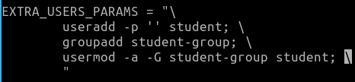
Classes – practical
Assume we got a task to add user to our image addition to root :
Show on terminal:
Edit our image file as we do in previous image slide
Add the below content of file:
Inherit extrausers
Build student-image
Run emulator :
Switch to user : su – student
Check what currently user : whoami
Check id user : id student
Check group user : groups student
.

Slide 44
Linux / U-boot Fragment – Method1
Demonstrate one of both in terminal:
Generate fragment Linux-kernel:
Bitbake linux-yocto–c menuconfig
Do your change , save and exit
Bitbake linux-yocto –c diffconfig
The bitbake will provide the location of generated fragment .cfg path – copy it
Copy .cfg to temp and name it with meaning name
Example : disable_bt.cfg
Generate fragment U-boot:
Bitbake u-boot –c menuconfig
Do your change , save and exit
Bitbake u-boot –c diffconfig
The bitbake will provide the location of generated fragment .cfg path – copy it
Copy .cfg to temp and name it with meaning name
Example : disable_spl.cfg

Slide 45
Linux Configuration – method1
Prepare the recipe and bbappend Linux-kernel
read kernel yocto version : bitbake –e linux-yocto| grep “^PV”
Mkdir –p ~/poky/YoctoStudent/recipes-kernel/linux/linux-yocto
Touch and Open for edit ~/YoctoStudent/recipes-kernel/linux/linux-yocto_%.bbappend
Write the below template
FILESEXTRAPATHS:prepend := “${THISDIR}/${PN}:”
SRC_URI +=“file://<cfg_file_name> “
Add your change .cfg file – for example disable_bt.cfg
Copy fragment file to ~/YoctoStudent/recipes-kernel/linux/linux-yocto
Build image

Slide 46
U-boot Configuration – method1
Prepare the recipe and bbappend U-boot
Check u-boot yocto version : bitbake –e virtual/bootloader | grep “^PV”
Mkdir –p ~/YoctoStudent/recipes-bsp/u-boot/u-boot
Touch and Open for edit ~/YoctoStudent/recipes-bsp/u-boot/u-boot_%.bbappend
Write the below template
FILESEXTRAPATHS:prepend := “${THISDIR}/${PN}:”
SRC_URI +=“file://<cfg_file_name> “
Add your change .cfg file – for example disable_bt.cfg
Copy fragment file to ~/YoctoStudent/recipes-bsp/u-boot/u-boot/
Build image

Slide 47
Linux / Uboot Configuration – method2
Use devtool for Linux-kernel
devtool modify linux-yocto - gernearte workspace for modify kernel
Devtool menuconfig linux-yocto – will open the menu
Change and save – will provide .cfg to workspace
Devtool finish linux-yocto - will provide bbappend with the change that will include the fragment file
Use devtool for U-boot
devtool modify u-boot - gernearte workspace for modify u-boot
Devtool menuconfig u-boot – will open the menu
Change and save – will provide .cfg to workspace
Devtool finish u-boot - will provide bbappend with the change that will include the fragment file

Slide 48
SDK - Toolchain
Disable ssl certificate (avoid Rafael WWW block)
Build/conf/local.conf
Add : BB_CHECK_SSL_CERTS = “0”
Save and exit
Run from build directory : bitbake <image> -c populate_sdk (please note this operation can take 1 hour and size addition of ~60G).
Cd /var/yocto/tmp/deploy/sdk
Run the bash install script that located in this directory .(.sh)
Go to path which you deploy the sdk in the installation.
Run : source envoirment-setup-<machine_name_arch>-<distro>-linux
Example: source envoirment-setup-core2-64-poky-linux
After source you can find the gcc / g++ according to machine arch , for example in case of x86_64 : x86_64-linux-gnu-gcc
Example : x86_64-linux-gnu-gcc main.c –o hellow

Slide 49
Practice

Slide 50
Practice
Exercise1:
create and add new layer to your project – name it ‘meta-student’ – verify that layer added .
Copy file core-image-minimal.bb (use find command ) to your recipe core inside your layer (recipes-core/images/) , name it student-image.bb
Build the image with this recipe
Run runqemu slirp nographic (from separate terminal)

Slide 51
Practice
Solution Execursie1
Bitbake-layers create-layer ~/meta-student
Bitbake-layers add-layer ~/meta-student
Bitbake-layers show-layers
Mkdir –p ~/meta-student/recipes-core/images
From ~/poky : find . –name core-image-minimal*
Cp ./meta/recipes-core/images/core-image-minimal.bb ~/meta-student/recipes-core/images/student-image.bb
Bitbake student-image
runqemu slirp nographic (from separate terminal in ~/poky , need to run . Oe before)

Slide 52
Practice
Exercise2:
Create a new toolchain for your project (use sdk slide)
Please note this operation can take ~1 hour and addition size of 60 G
Edit simple hellow-world.c that do some print to screen and save
Compile it use your cross-compiler sdk (gcc-*) – follow the sdk slide .
Verify you have executable file .

Slide 53
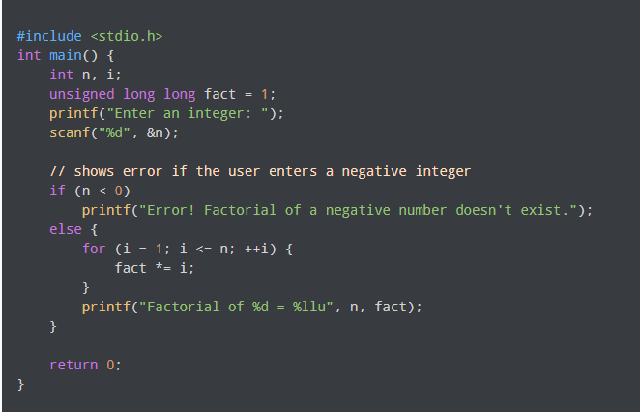
Practice
Solution Execursie2
Follow the steps according in SDK slide
Vim /tmp/factorial.c
Copy the below to this file and save
x86_64-linux-gnu-gcc /tmp/factiorial.c –o factioral

Slide 54
Practice
Exercise3:
Step1:
Add new recipe inside the layer from ex1 , call it recipe-<name_app> that implement the below :
Compile the file
Install the file to /usr/bin
Install the application to the image – in the image you create in ex1
Build and run the emulator
Check that you can run the application in the target
Hint : check ‘meta-skeleton’ for template.
Step2:
Add new recipe that called ‘recipe-init’
In this task need to use sysvinit init-manager , follow the below:
Create .bb file that add an init script to your image
The init script will run the app from ex1 and direct log as follow name_app > /tmp/log.txt
Hint : use template file recipes-init that copied to docker in /var/yocto/practice/recipes-init
Build and run the emulator
Print the log : cat /tmp/log.txt

Slide 55
Practice
Solution Execursie3
Step1
From ~/poky
Mkdir –p ../meta-student/recipes-apps/factiorial/hellow-single/
Cp –rf meta-skeleton/recipes-skeleton/hellow-single/* ../meta-student/recipes-apps/factiorial/
Mv ../meta-student/recipes-apps/factiorial/hello_1.0.bb ../meta-student/recipes-apps/factiorial/factiorial_1.0.bb
Edit factiorial – change all the hello world to factiorial (compile and install)
Mv ../meta-student/recipes-apps/factiorial/files/helloworld.c ../meta-student/recipes-apps/factiorial/files/factiorial.c
Edit the code ../meta-student/recipes-apps/factiorial/files/factiorial.c
Add to image : student-image.bb -> add to vatiable IMAGE_INSTALL:append = “factiorial”
Bitbake student-image
Runqemu slirp nographic
Run application

Slide 56
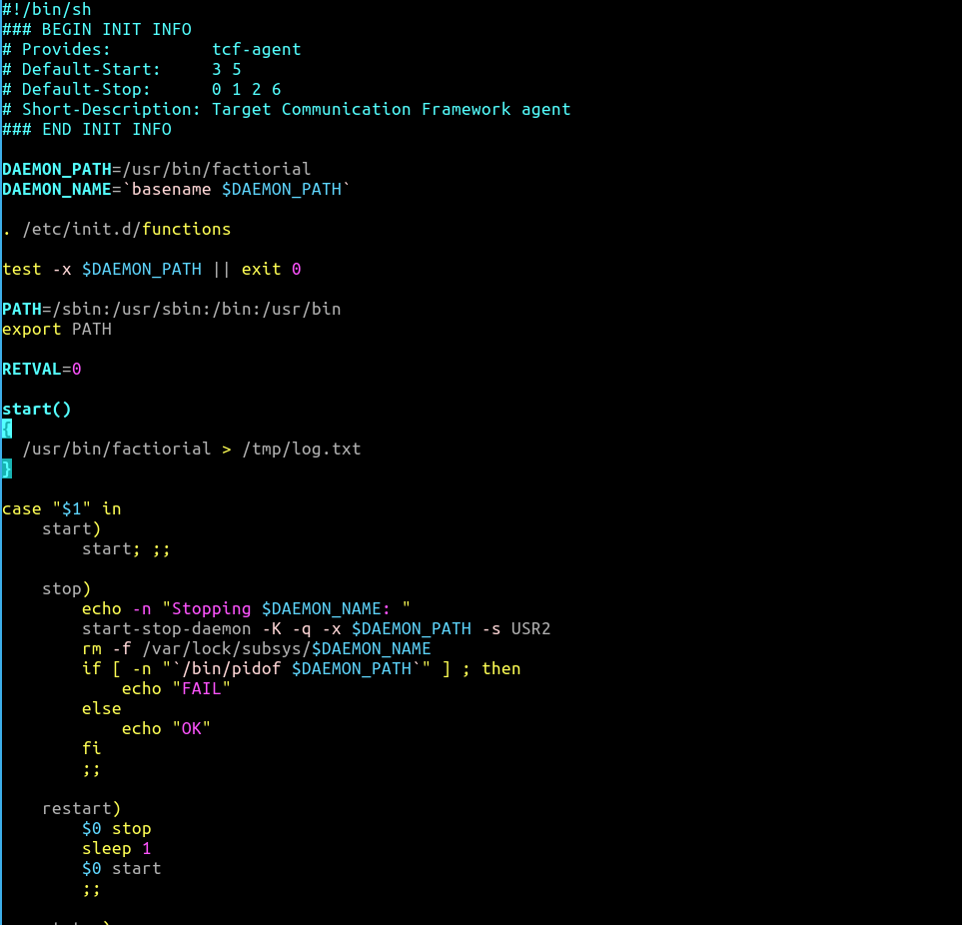
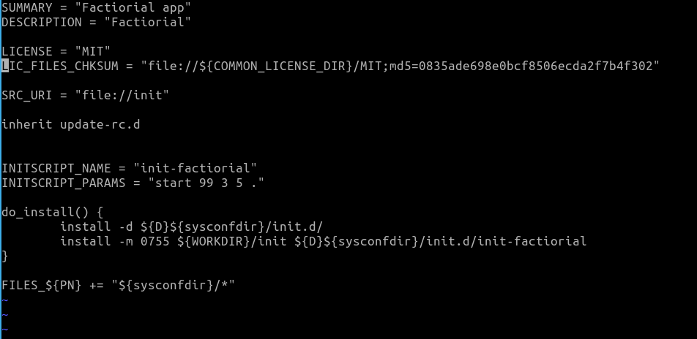
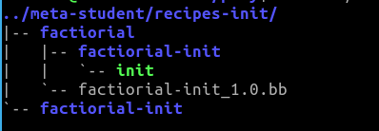
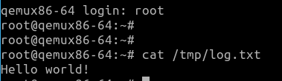
Practice
Continue Solution Execursie3
Step2
Mkdir –p ../meta-student/recipes-init/factiorial/factiorial-init
Copy recipe .bb init template to ../meta-student/recipes-init/factiorial/
Copy init script template to ../meta-student/recipes-init/factiorial/factiorial-init/
Edit recipe and rename according the app
Edit the init according.
Add the recipe to image in your layer
Build and run

Slide 57
Practice
Exercise4:
Step1:
Create bbclass and call it debug_tools
Write inside it all the debug tools you want to it : stress-ng, valgrind
Step2:
Add to your custom image the debug_tools by use inherit
Build and run
Check that you have these tools in your image

Slide 58
Practice
Solution Exercise4:
Step1
Mkdir ../meta-student/classes
Vim ../meta-student/classes/student_debug_tools.bbclass
IMAGE_INSTALL:append = “ stress-ng valgrind”
Step 2
Add this line to the recipe for image Inherit += “student_debug_tools”
Build image
Run these tools to check if they are running and exist

Slide 59
Practice
Exercise5:
Step1:
Change the recipe-init script that the application will direct the print to /dev/kmsg – kernel log
Build and run
Note that you should see the print of the app to the screen and not just the log ? Why?
Step2:
Configure the kernel following the below , you can use 2 methods : devtool or create fragment and manually add it to bbappend.
Disable the print of the kernel log to the screen by configuration of the log level in kernel configuration.
Search for variable CONSOLE_LOGLEVEL_DEFAULTS
Build and run
Hint : use template file recipes-kernel that copied to docker : /var/yocto/practice/recipes-init

Slide 60
Practice
Solution Exercise5:
Step1: edit ../meta-student/recipes-init/factiorial/factiorial-init/init and change path from /tmp/log.txt
to /dev/dmesg
Step2:
Method1:
Devtool modify linux-yocto
Devtool menuconfig linux-yocto
Menu->Kernel hacking->printk and dmesg options->default console loglevel – change to 4
Devtool finish linux-yocto ../meta-student
Build student-image
run
Method2
Bitbake linux-yocto –c menuconfig
Change the CONSOLE_LOGLEVEL to 4
Save and exit
Bitbake linux-yocto –c diffconfig
Mkdir ../meta-student/recipes-kernel/linux/linux-yocto
Cp the fragment output from the last command to ../meta-student/recipes-kernel/linux/linux-yocto , name it with meaning name
Edit or copy linux-yocto_%.bbappend and add the fragment name to it
build

Slide 61
Linux Commands
Search text into folders and directories
Find –type f –exec grep –lr “text” {} \;
Search file name
Find . –name <name>

Slide 62
Yocto with Xilinx BSP layers

Slide 63
Xilinx Layers
Yocto-poky – layers default:
Link : yoctoproject/poky at honister (github.com)
meta-xilinx:
Link : Xilinx/meta-xilinx at honister (github.com)
Add layers : meta-Xilinx-core , meta-Xilinx-bsp (require meta-oe) , meta-Xilinx-standalone
Readme : meta-Xilinx-core
meta-oe:
Link : openembedded/meta-openembedded at honister (github.com)
Add layer : meta-oe
Meta-xilinx-tools:
Link : Xilinx/meta-xilinx-tools at honister (github.com)
Add layers : meta-Xilinx-tools (require meta-oe,meta-Xilinx-standalone,meta-poky)
ReadMe : meta-Xilinx-tools – see HW config with XSA.

Slide 64
Yocto with Xilinx Configuration
Packages to install:
Yocto Project Quick Build — The Yocto Project ® 3.4.999 documentation
Local.conf (edit override machine file according to slide 67)
MACHINE= “ zcu102-zynqmp-rf”
bblayer.conf
<project_dir>/meta-openembedded/meta-oe
<project_dir>/meta-Xilinx/meta-xilinx-bsp
<project_dir>/meta-Xilinx/meta-xilinx-core
<project_dir>/meta-Xilinx/meta-xilinx-standalone
<project_dir>/meta-Xilinx-tools

Slide 65
Xilinx Configuration
Create own layer or add it to distro the below configuration:
Config image as initramfs:
IMAGE_FSTYPES:remove = “wic.qemu-sd”
INITRAMFS_IMAGE = “core-image-minimal”
enable generated boot script
EXTRA_IMAGEDEPENDS:Append = “ u-boot-zynq-scr”
Config image as FIT image
KERNEL_CLASSES += “kernel-fitimage”
KERNEL_IMAGETYPES:append = “ fitImage”
UBOOT_ENTRYPOINT_zynqmp = “0x80000”
UBOOT_LOADADDRESS_zynqmp = “0x80000”
Hardware Description (XSA)
HDF_BASE= “file://”
HDF_PATH = "/<absolute-path-to-xsa>/system.xsa"

Slide 66
Xilinx Configuration
Hardware Description (XSA) - continue
Link to XSA files : hdf-examples/ at rel-v2020.1 · Xilinx/hdf-examples (github.com)
LICENSE
Add this line to your project layer : LICENSE_FLAGS_WHITELIST += “Xilinx”
Config Device tree
Add configuration for your custom device-tree according link below
Customizing Device Trees in Xilinx Yocto - Xilinx Wiki - Confluence (atlassian.net)
Set the variable SYSTEM_USER_DTSI to the full path to your system-user.dtsi file
Create file system-user.dtsi in the location you create
In order to see the source device tree and psu files , should run : bitbake device-tree –c compile –f
You can find the sources : build/tmp/work/<image_linux_name>/device-tree/xilinx-…./device-tree-build/device-tree/
Example :

Slide 67
Xilinx Configuration - Machine
Add override for your selected machine – example zcu102:
Under your project layer:
<project_name>/conf/machine/zcu102-zynqmp-rf.conf
Add the below content:
require conf/machine/zcu102-zynqmp.conf
MACHINEOVERRIDES =. “zcu102-zynqmp:”
UBOOT_ENTRYPOINT = “0x80000”
UBOOT_LOADADDRESS = “${UBOOT_ENTRYPOINT}”

Slide 68
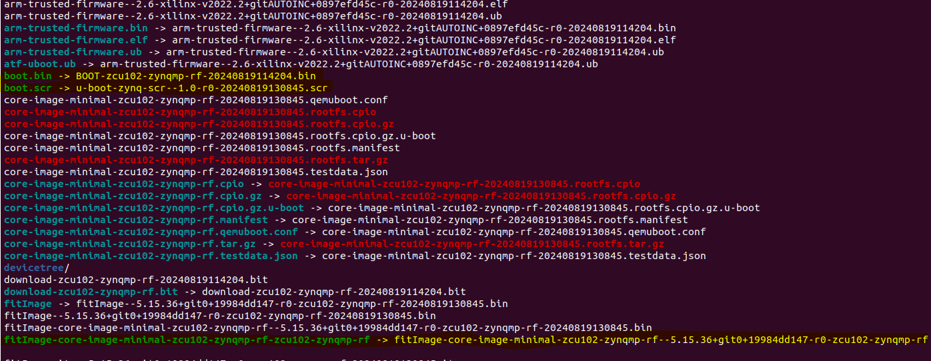
Artifact – Xilinx
Path to Artifact:
Build/tmp/deploy/images/<name_machine>/
Important basic Deploy Files
Boot.bin
Boot.scr
fitImage-<image_name>-<machine_name>-<machine_name>

Slide 69
Commands yocto relate to xilinx
Config kernel:
Bitbake linux-xlnx –c menuconfig
Bitbake linux-xlnx –c diffconfig
Config U-boot:
Bitbake u-boot-xlnx –c menuconfig
Bitbake u-boot-xlnx –c diffconfig
Fsbl (PATCHS)
Generally need to add fsbl directory in your project : <my_project>/recipes-bsp/fsbl/files
In <my_project>/recipes-bsp/fsbl/fsbl_%.bbappend
Write the below :
FILESEXTRAPATCHS:prepend := “${THISDIR}/files”
SRC_URI:append = “file://file.patch”

Slide 70
Appendix Rafael shield distro

Slide 71
Layers Overview
There are 3 important layers in the build structure
Poky Yocto reference layer - distro .
Shield distro layer - our customized distro
this layer is used poky distro and do some addition customization for this layer .
Project Layer - customized layer per project
This layer is used specific per project , this is the most high level layer that provided specific with project , it include select machine target,xsa file , device-tree, fsbl specific or uboot configuration ,linux packages specific , modules , drivers , app and so on.
Project layer
Shield-distro
Meta -POKY

Slide 72
Distro Layer - Overview
Distribution: specific implementation of linux (kernel version,rootfs,etc)
The distribution layer provides policy configuration for your distribution.
Best practice that you isolate these types of configuration into their own layer.
Settings you provide in conf/distro/distro.conf
In distribution layer usually you will find:
Classes – hold common functionality that can be shared among recipes in the distribution
Conf – hold configuration files for the layer
Recipes – recipes and append files that affect common functionality

Slide 73
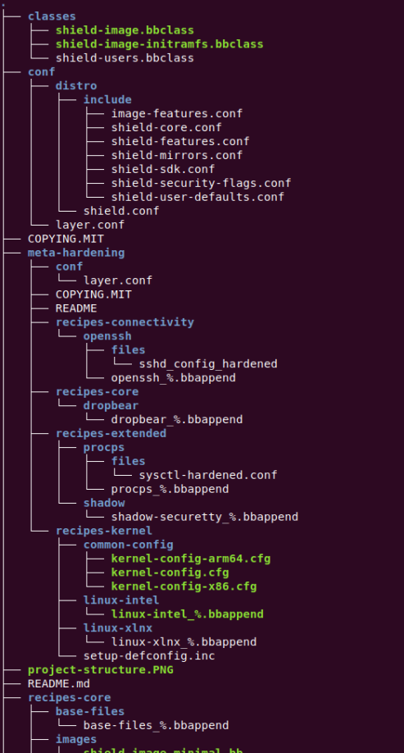
Inherit image flow and structure
./core/poky/meta/classes/image.bbclass
image
Class poky
POKY-meta-distro
inherit image
./core/poky/meta/classes/core-image.bbclass
-inherit Core-image - inherit shield-users
Class shield
ext/rafael/meta-shield/classes/shield-image.bbclass
Recipe bitbake : bitbake cxy-image-minimal
Meta-shield-distro
inherit
Shield-image
ext/rafael/meta-shield/classes/shield-image-initramfs.bbclass
Meta-project-layer
inherit shield-image-initramfs
meta-project-cxy/recipes-core/images/cxy-image-minimal.bb

Slide 74
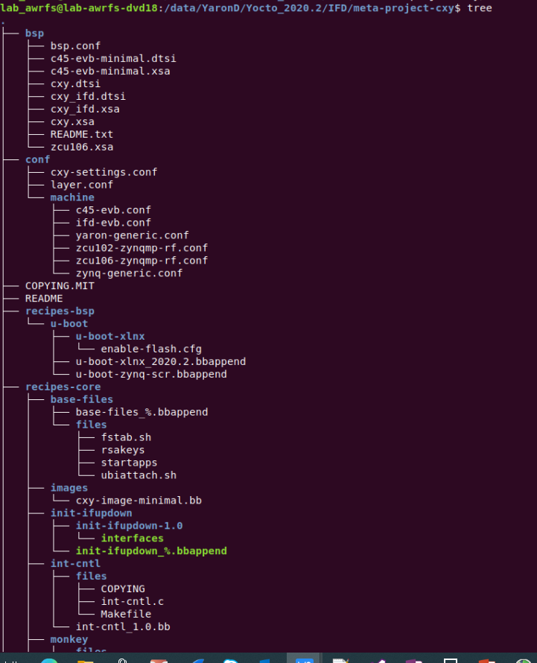
project Layer structure
Bsp – include device-tree , XSA files per target
Conf – configuration per project
Machine – include machine file per project
Recipes bsp : include u-boot,fsbl,pmu,etc..
Recipes-core : include base files , scripts run and ability to add files to rootfs , can used to configure add permission , add aliases and more .
Images – should contain the recipre name to build the image specific for projects
Can contain application source
Can contain drivers and modules .
Can contain kernel specific configuration.
Configure the network and IP’s

Slide 75
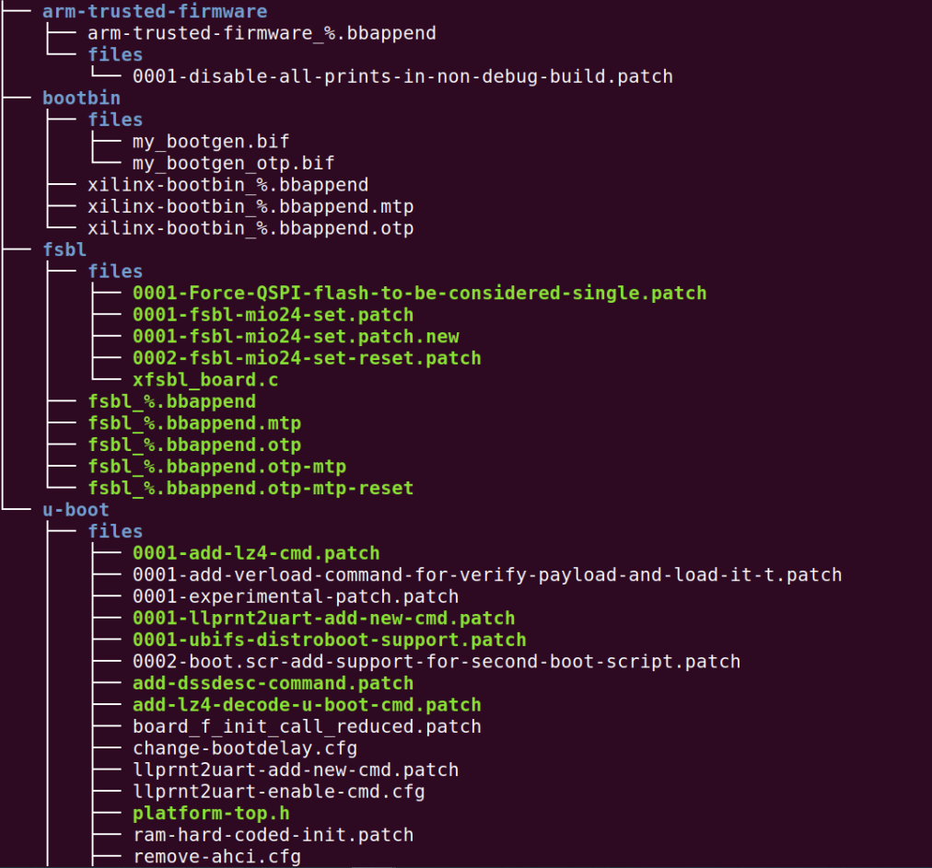
BSP layer / recipes - Overview
Machine: defines the architecture, pins, buses , BSP etc.
The BSP layer provides machine configuration that target specific hardware.
All in this layer is specific to the machine for which you can building the image
The BSP layer configuration directory configuration files for the machine – conf/machine/machine.conf
FSBL – implements patches on source file , settings
UBOOT - implements patches on source file , configuration
SENSORS
MULITMEDIA
PMU
FPGA
BITSTREAM
ETC..

Slide 76
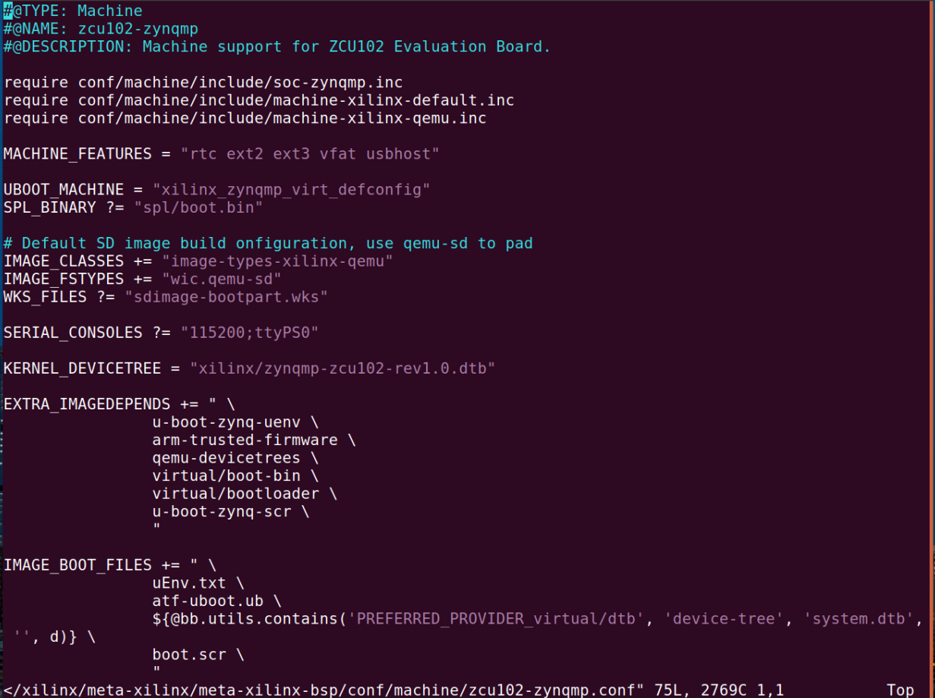
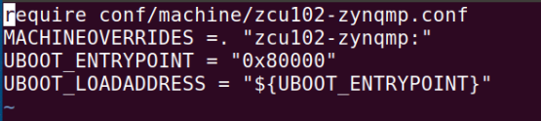
BSP – machine structure
From project bsp layer :meta-project-cxy/conf/machine/zcu102-zynqmp-rf.conf
From Xilinx bsp layer : /xilinx/meta-xilinx/meta-xilinx-bsp/conf/machine/zcu102-zynqmp.conf
In local.conf :

Slide 77
Rafael layers packages
meta-dss – This layer contains target tool.
Meta-fsb – new generation driver (high speed technology network)
Meta-gigevision – is a communication standart designed for industrial cameras used in machine vision and imaging applications.
Meta-htp - scripts required by Rafael's HTP target program. Used for testing the board
meta-linux-debug-settings - A layer that allows to easily enable many useful linux debug settings
meta-linux-drivers - A layer for various Linux drivers
meta-linux-libs - A layer that contains various libs for Linux.
meta-linux-utils - general Linux utilities
meta-openrc-ext - An extension to meta-openrc layer
meta-process-isolation - This layer provides process isolation functionalty based on NsJail utility.
meta-realtime-kernel - RT patch + relevant kernel configuration for real-time scheduling.
meta-xilinx-wrapper - A wrapper over Xilinx layers

